Slide 1
D6290 Public Image Club Showcase

Slide 2
Featuring
Big Rapids
Elk Rapids
Grand Rapids
Sault Ste. Marie, ON

Slide 3
Print, Outdoor & Social Media Goal: Awareness & Membership
Notes:
Approximately 50 members
4x increase in sessions, 3x increase in website page views
Net gain of six members (10 new)
$1,500 (District funds $750)

Slide 4
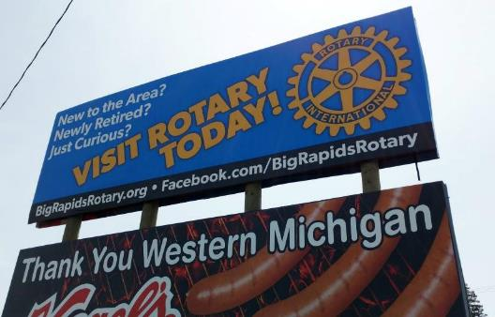
Big Rapids – Print & Outdoor
8 placements of 2 x 4 in. ad
Billboard est. 43,200 monthly views

Slide 5
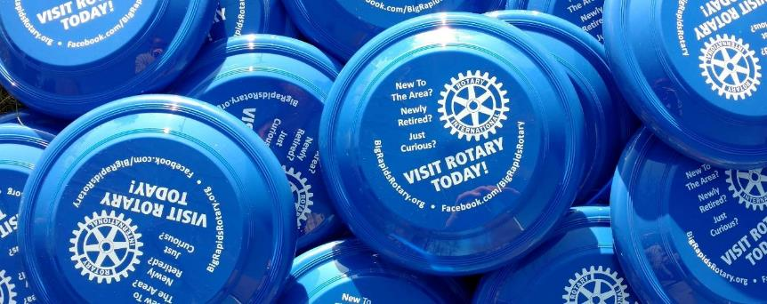
Big Rapids – Promotional Give-aways
Purchased 250 to hand out at spring parades, festivals and expos

Slide 6
Big Rapids – Social Media

Slide 7
Big Rapids – Website
Total Club Investment: $761
Increased number of guests
Increase in new website visitors
20% increase in membership

Slide 8
Engaging Video to Promote Youth Programs Goal: Increase youth awareness of Rotary
Notes:
Partnerships with Robotics Team and with Interact

Slide 9
Great Partnership
College Student shot footage, edited and produced video
Interviews w/students were edited and grouped by question
Coordinated “launch” of video involved club, club members, Interact & Robotic students, targeted school faculty & administrators, Chamber of Commerce

Slide 10
Great Partnership
Club investment in video was $500 (negotiated from $2,500)
Leveraged funds from D6290 Public Image matching grant
Released 9 Sept 2016 – over 5.6k views on Facebook within weeks
Received responses for club’s Haiti trip from 5 members, 3 Interact students, and 1 teacher

Slide 11
Social Media – #ServiceAboveSelfie Goal: Community Awareness

Slide 12
Engaging Community

Slide 13
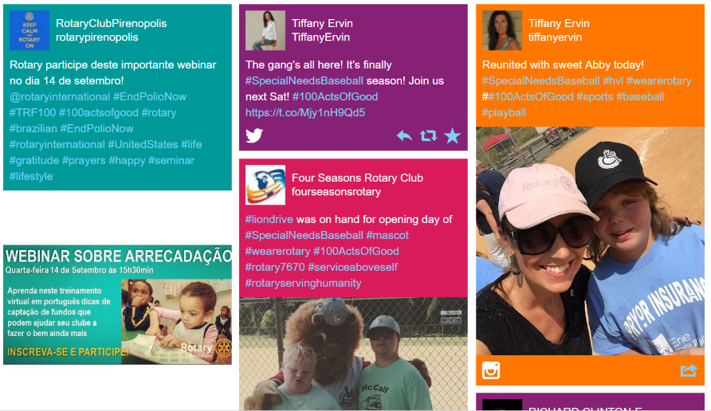
Consolidated Posts To WebPage (https://www.juicer.io)
Over 50 entries
Reached over 93,000 people
Awards presented live at GR sports event w/10k+ attendees
#ServiceAboveSelfie
#rotarygr
Notes:
Service Above Selfie social media campaign, which reached over 93,000 people and had over 50 entries. At intermission (Griffin’s game), the Club will present a check to Grandville Avenue Arts & Humanities, the winning organization of the Service Above Selfie contest. The finalists were:
Grandville Avenue Arts & Humanities (first place) ;
Help Pregnancy Crisis Aid through the Aquinas Campus Ministry and the Dominican Sisters of Grand Rapids (second place); and
Habitat for Humanity (third place).

Slide 14
Promoting events using social media Goal: Increase awareness, attendance, support

Slide 15
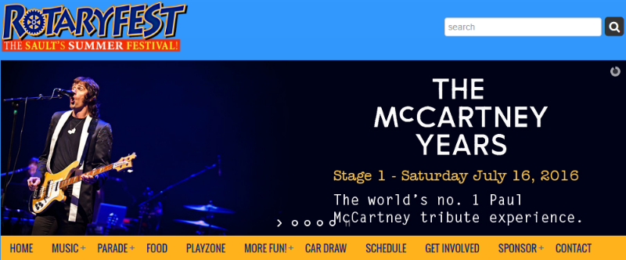
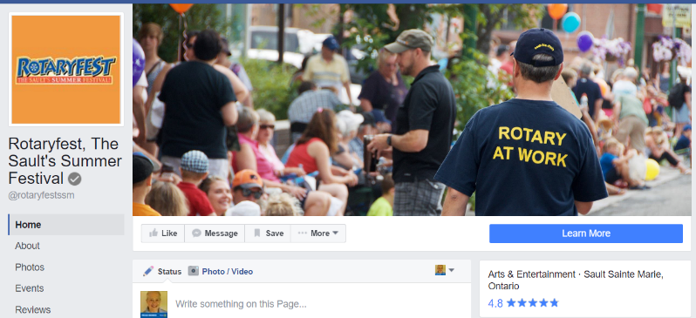
Event Central!

Slide 16
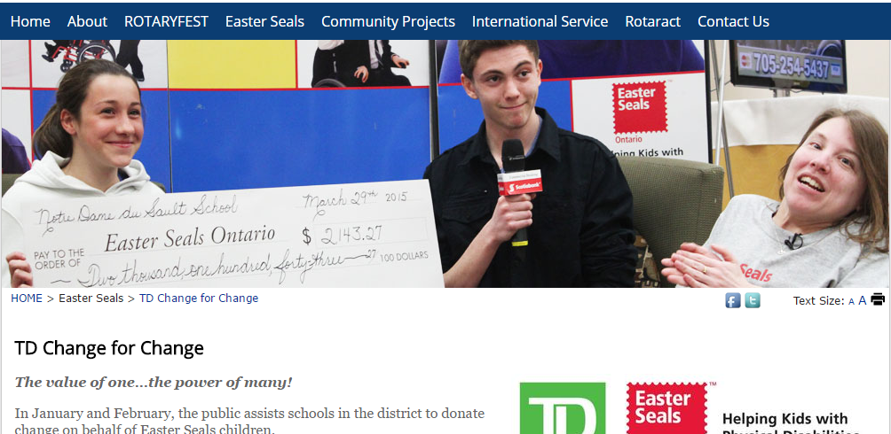
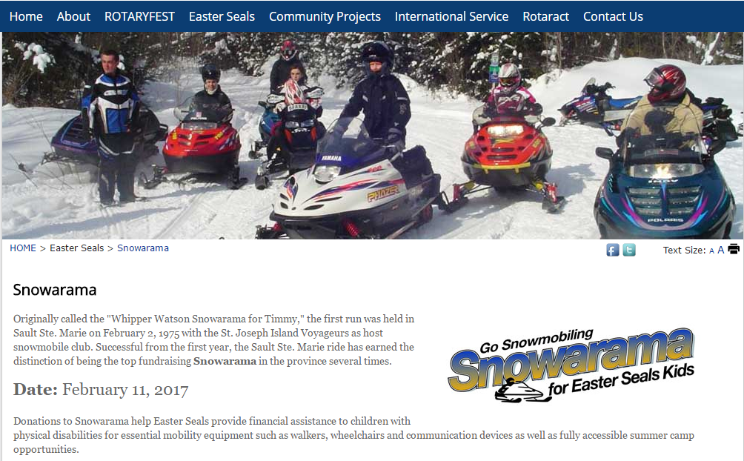
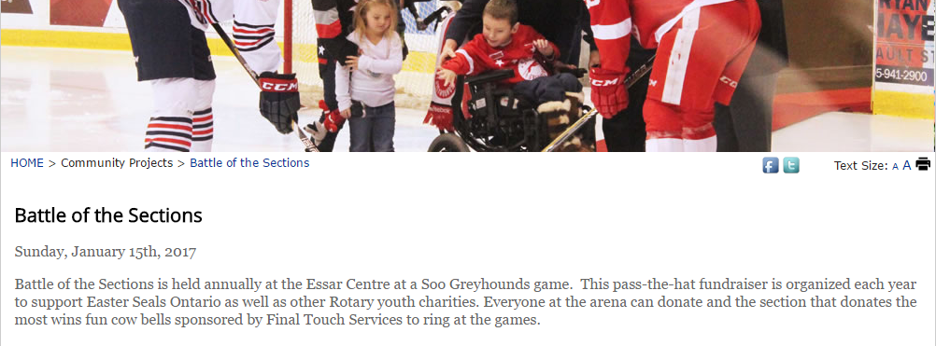
Easter Seals Fundraising

Slide 17
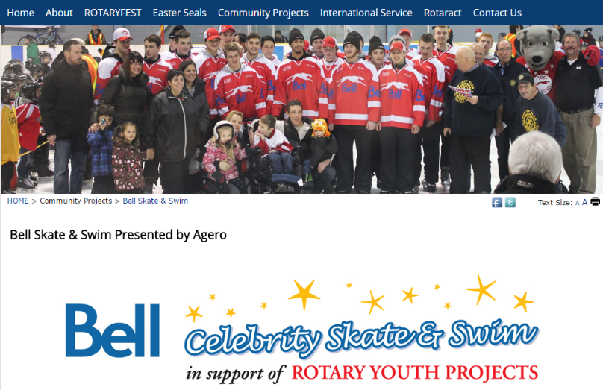
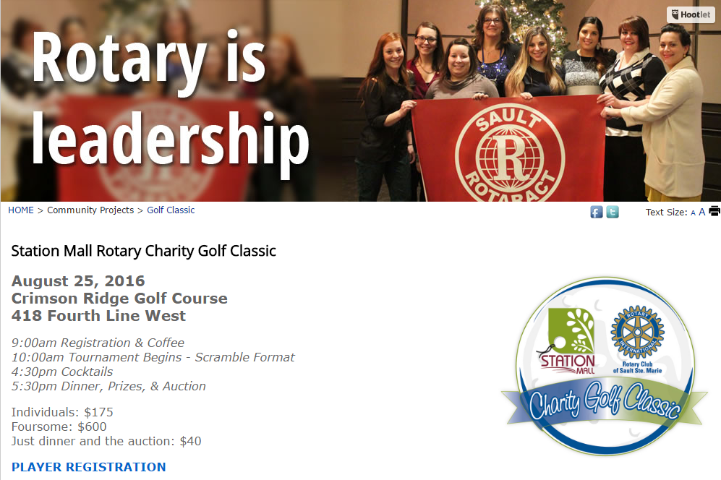
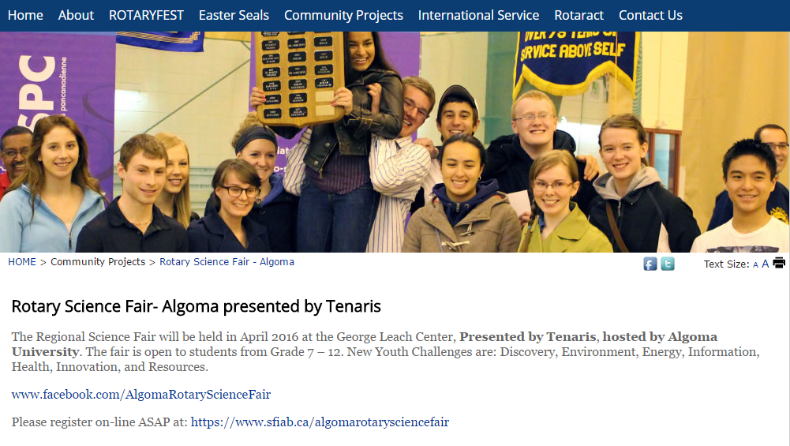
Youth Services Fundraising

Slide 18
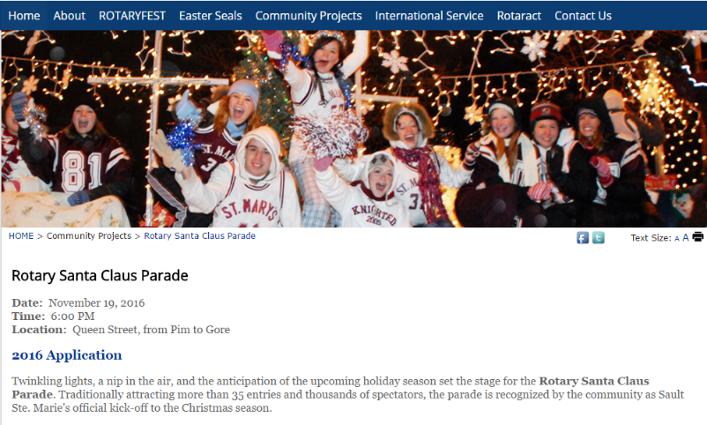
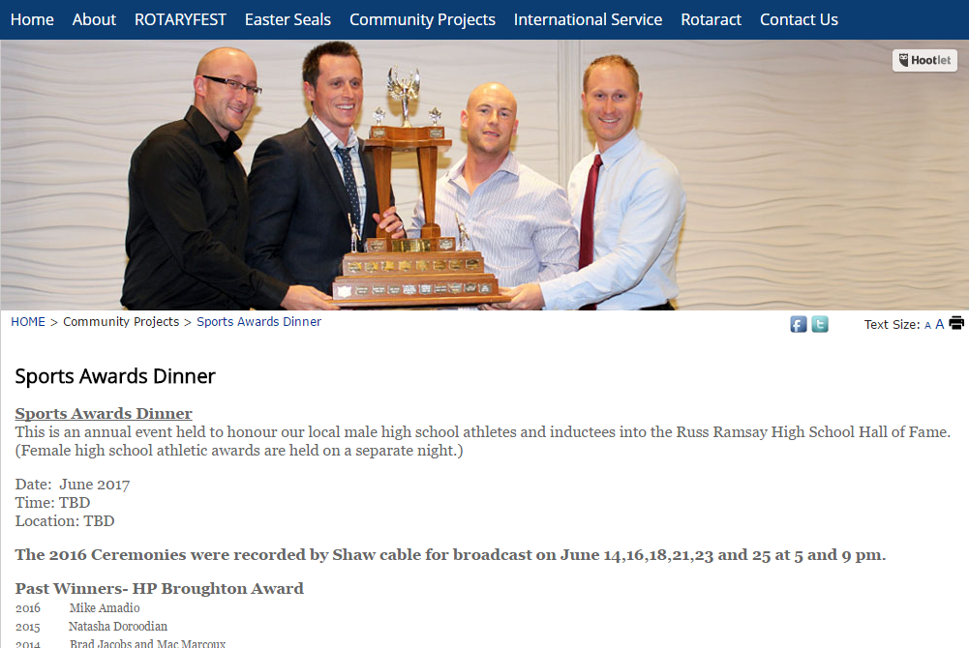
Community Awareness / Service

Slide 19
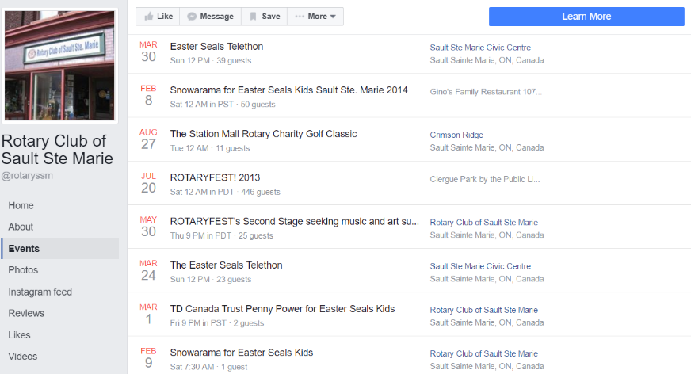
Promoting Events via Facebook

Slide 20
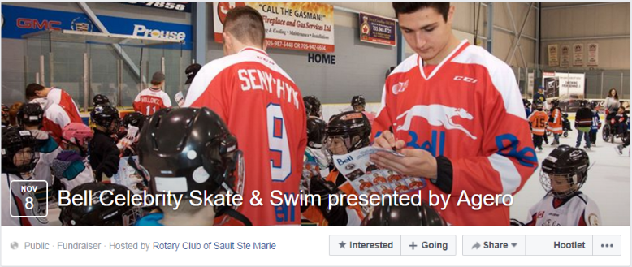
Facebook Events
Easily shared
Increases reach
FB recommends
Boosts/Ads
Use photos & videos
Increase frequency leading up to event
Photos & live video from event

Slide 21
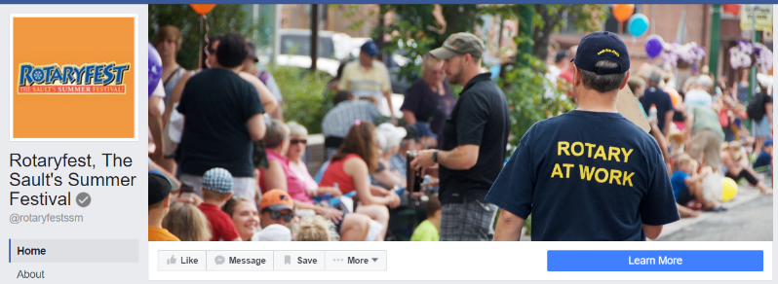
Facebook Event Pages
For large-scale events
Allows events within events
Supports donate button
Build longer term fan base
Use photos & videos
Increase frequency leading up to event
Photos & live video from event

Slide 22
Important Reminders
Establish event hashtag (#) in advance and communicate to members/volunteers/sponsors/media
Have an assigned photographer/videographer
Enlist members to reinforce social media promotion (shares)
Cross-promote on all available channels (website, Facebook/Twitter/LinkedIn etc, local media social media pages, Chamber/Visitor Center social media pages)

Slide 23
Highlights
Establish consistent message and graphics
Catchy tag line
Reinforce across multiple channels
Know your audience e.g. youth create youth promo
Engage youth in supporting initiatives
Find relevant and large community events as venues to present awards / grants
Leverage Social Media to promote events

Slide 24
Have something to share?
Nancy Thornton, D6290 Public Image Coordinator 248 520 0614 nthornton@centos.net

